Slide 1
Handle
Input Field

Slide 2
In React, unlike plain HTML, we don’t directly access the DOM using document.getElementById.
Instead, React controls the input’s value using state — this makes it a Controlled Component.
This allows React to:
Keep UI and data in sync
Validate or modify input instantly
Easily clear/reset form values
Make complex forms predictable

Slide 3
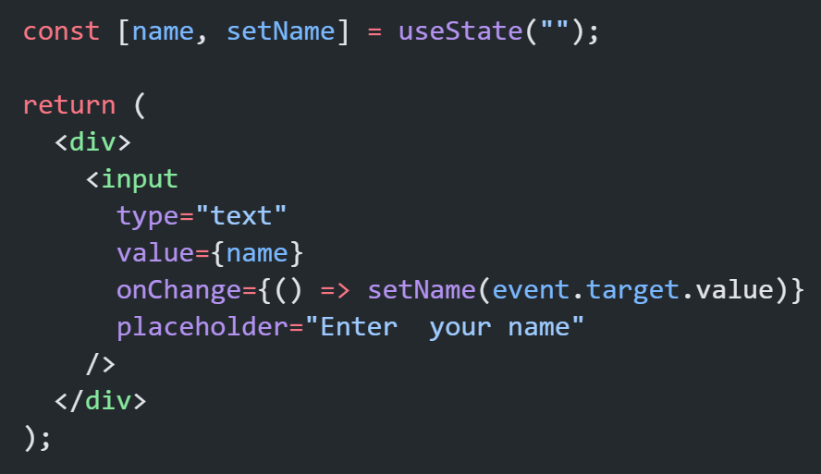
value → connected to state
onChange → updates state
Without onChange, the input becomes read-only

Slide 4
What is Controlled Components?
A controlled component is a form whose input field value is controlled by React’s State.
Here’s how it works:
Store input field value in state
Use change handler with input field
Value attribute attached with state

Slide 5
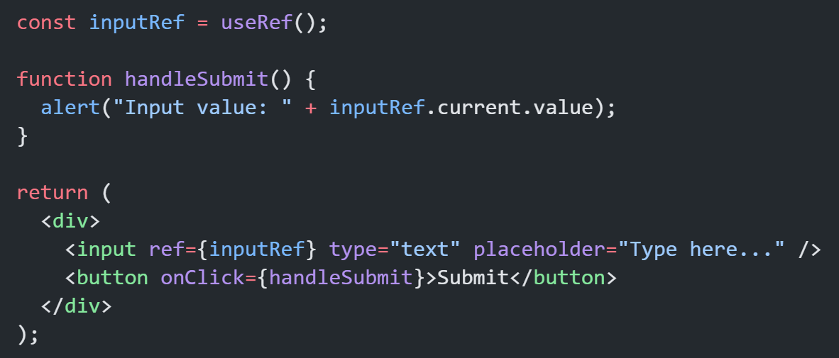
Uncontrolled Components
Sometimes we don’t bind the input to state — we directly access it via ref.

Slide 6
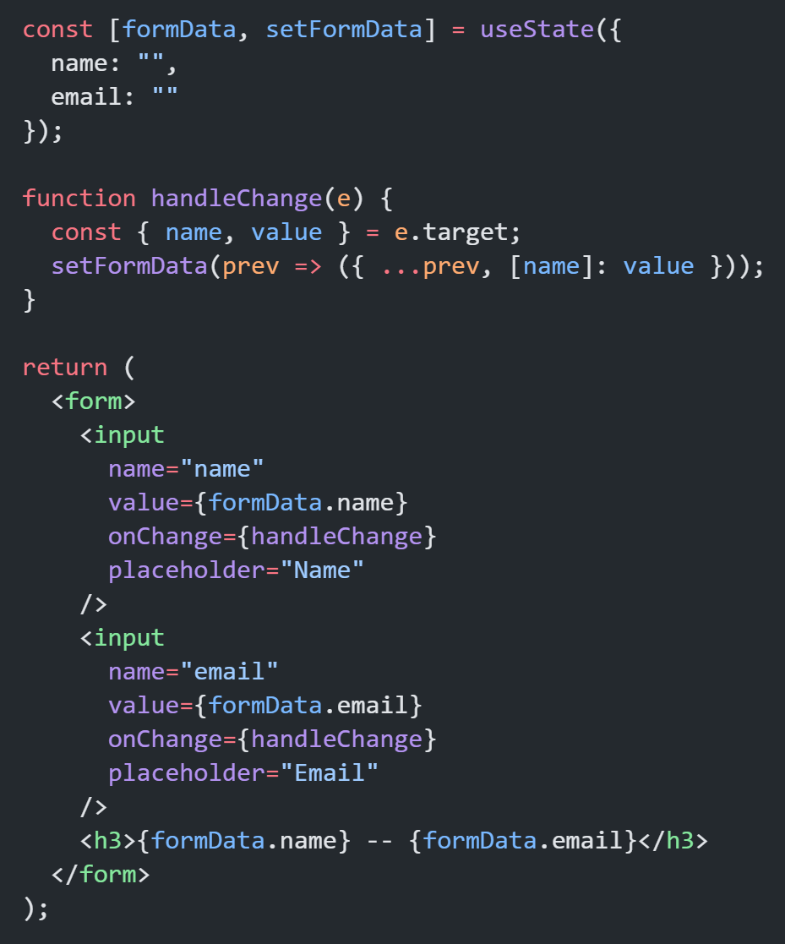
Multiple Input Fields
When handling multiple inputs, use one state object.
Dynamic key [name]: value
Spread operator ...prev to keep previous data intact

Slide 7
Thank You

